Slide 1
Study Group – Capitolul 3
Oracle Certified Associate

Slide 2
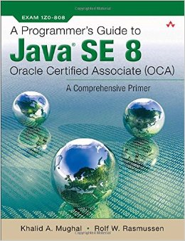
A Programmer's Guide to OCA Java SE 8 Certification: A Comprehensive Primer

Slide 3
Intrebari?
Intrebari pe baza materialului

Slide 4
Grile

Slide 5
msg systems ag
Robert-Buerkle-Str. 1, 85737 Ismaning/Munich
Germany
Phone: +49 89 96101-0
Fax: +49 89 96101-1113
info@msg-systems.com
www.msg-systems.com

Slide 6
Name Surname
Function
+49 (0) 175 / 23456789
name.surname@msg-systems.com
msg systems ag
Robert-Buerkle-Str. 1, 85737 Ismaning
Germany
www.msg-systems.com
Name Surname
Function
+49 (0) 175 / 23456789
name.surname@msg-systems.com

